Slide 1
India
HISTORICAL TIMELINE

Slide 2
EARLY SETTLEMENT

Slide 3
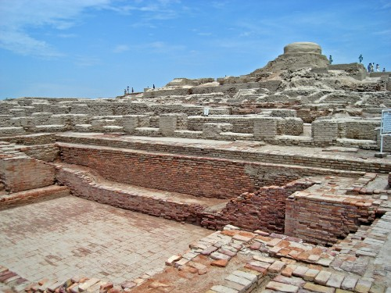
The Indus Valley Civilization
The Indus Valley Civilization, also known as the Harappan Civilization flourished around 2,500 BC, in the western part of South Asia.
The Indus civilization apparently evolved from the villages of neighbors or predecessors, using the Mesopotamian model of irrigated agriculture with sufficient skill to reap the advantages of the spacious and fertile Indus River valley. ( “Indus Civilization,” 2015).

Slide 4
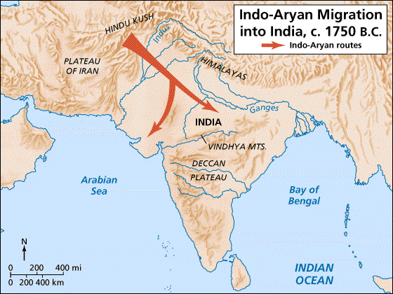
The Disappearance of the Indus Civilization
By 1500 BC, the Harappan culture came to an end. Among various causes ascribed to the decay of Indus Valley Civilization are the invasion by the Aryans, the recurrent floods and other natural causes like earthquake, etc. ( “Ancient History, ” 2015).
Image: http://www.facts-about-india.com/aryans-arrival-in-india.php

Slide 5
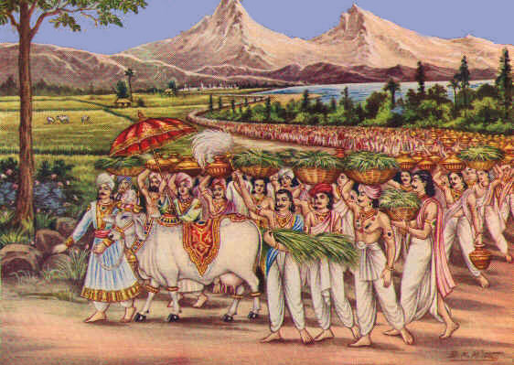
Vedic Civilization
Period when the basic foundations of Indian civilization were laid down. These include the emergence of early Hinduism as the foundational religion of India, and the social/religious phenomenon known as caste. (“Ancient History, ”2015).
The Vedic Civilization flourished along the river Saraswati.
Image: http://www.harekrsna.com/practice/4regs/vegetarian/dharma.htm

Slide 6
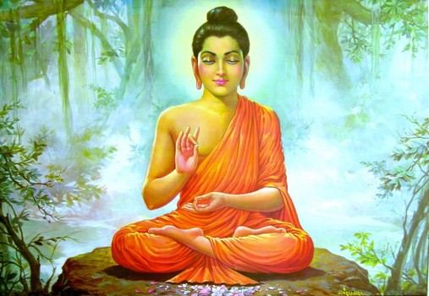
The Buddhist Era
Buddha was born in BC 560 and died at the age of eighty in BC 480. Buddha, whose original name was Siddhartha Gautama, was the founder of Buddhism, the religion and the philosophical system that evolved into a great culture throughout much of southern and eastern Asia. (“Ancient History, ” 2015).
Image: http://www.examiner.com/article/celebrate-lord-buddha-s-birthday-and-the-full-moon

Slide 7
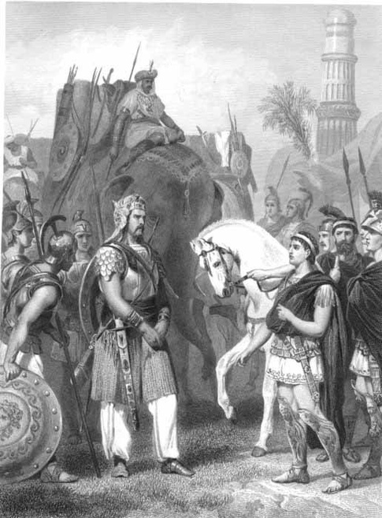
The Romans Invade
In 326 BC, Alexander invaded India. The Indians were defeated in the fierce battle, even though they fought with elephants, which the Macedonians had never before seen. Alexander captured Porus and, like the other local rulers he had defeated, allowed him to continue to govern his territory. (“Ancient History, ” 2015).
Image: https://www.quora.com/Why-didnt-Alexander-the-Great-invade-India

Slide 8
Historical Events

Slide 9
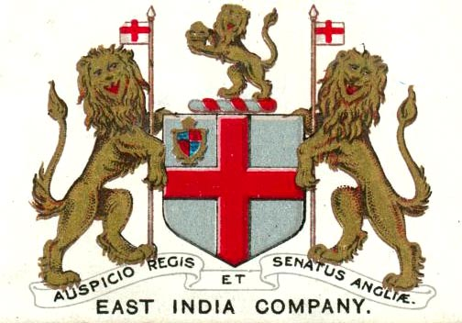
East India Company
1600
Queen Elizabeth I granted a charter to the East India Company established trading posts in Bombay, Calcutta, and Madras

Slide 10
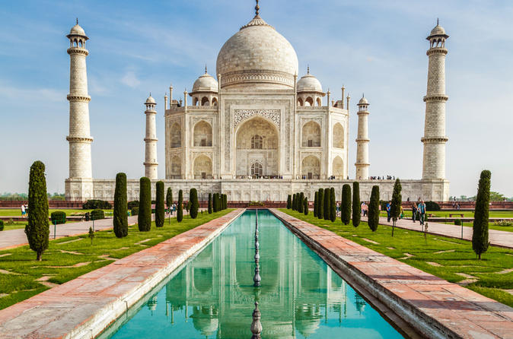
The Taj Mahal
1638
Mogul Emperor Shah Jahan begins construction of the Taj Mahal in memory of his wife Mumtaz.

Slide 11
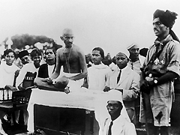
Mohandas Gandhi
1915
After studying law in Britain and fighting for Indian rights in South Africa, Mohandas Gandhi launches a campaign of nonviolent resistance against British rule in India. Gandhi is called Mahatma, meaning "Great Soul."

Slide 12
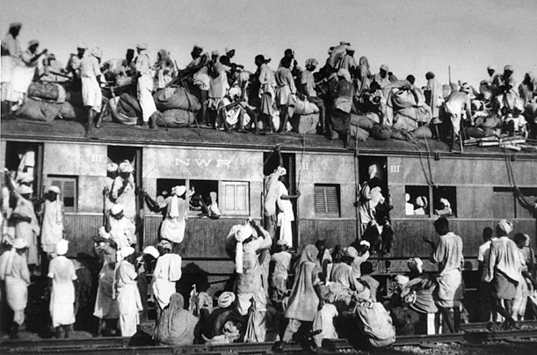
Independence and Partition
1947
Muslim refugees crowd onto a train near New Delhi during the bloody Partition of Hindu-majority India and Muslim-majority Pakistan. Some 15 million people are displaced and an estimated 500,000 killed in the savage violence sparked by Britain's division of its former colony.

Slide 13
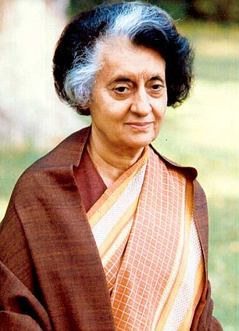
Women in Power
1966
Indira Gandhi (not related to Mahatma) becomes Prime Minister and one of the first women elected to lead a nation.

Slide 14
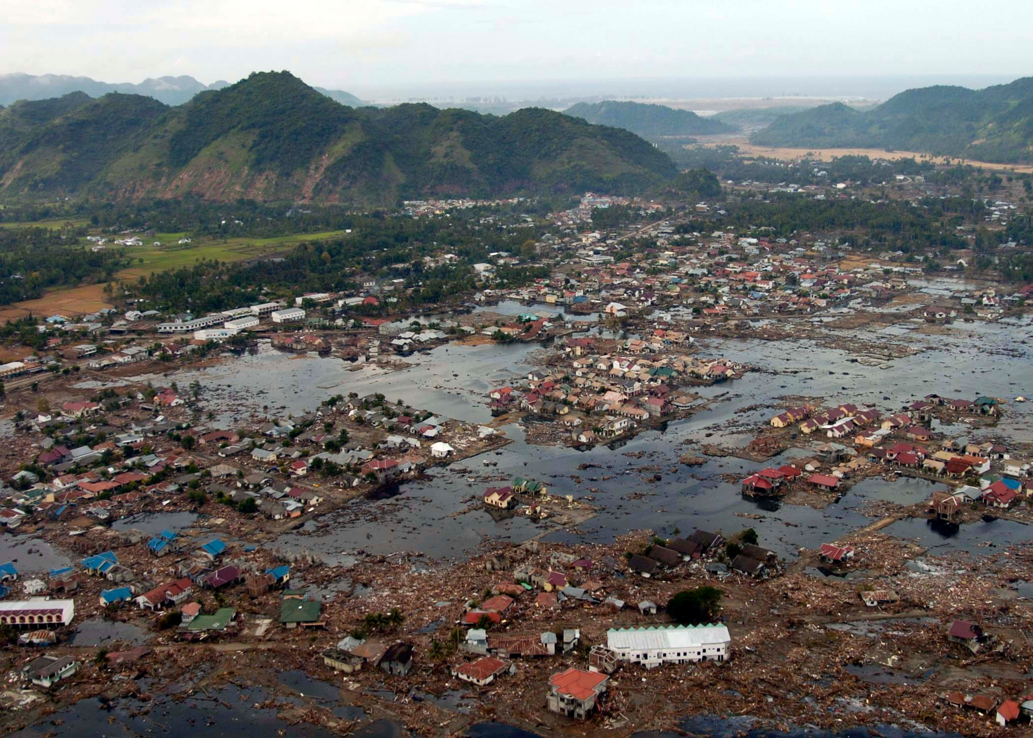
Natural Disasters
2004–2005
A series of natural disasters, including floods, earthquakes and tsunamis, brings destruction to southern coastal communities.

Slide 15
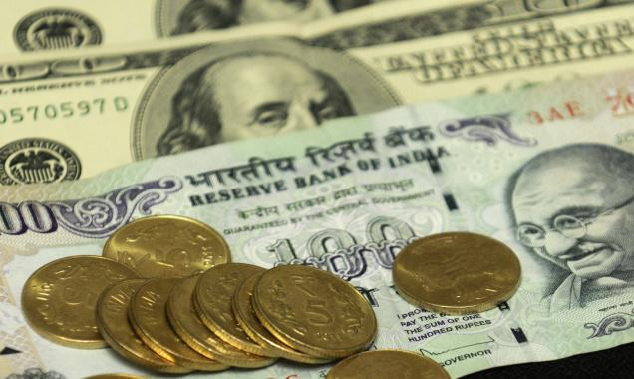
The Sky's the Limit
2007
In early July, the Bombay Stock Exchange Sensex Index eclipses the 15,000 mark for the first time. The milestone means India's markets have soared fivefold in five years.

Slide 16
Resources
East India Company. (2015). In Encyclopædia Britannica. Retrieved from http://www.britannica.com/topic/East-India-Company
History India Timeline. (n.d.). Retrieved November 23, 2015, from http://www.datesandevents.org/places-timelines/22-history-india-timeline.htm
India Timeline. (n.d.). Retrieved November 23, 2015, from http://www.timeforkids.com/destination/india/history-timeline
Photos: India's Turning Point. (n.d.). Retrieved November 23, 2015, from http://content.time.com/time/photogallery/0,29307,1649065_1420808,00.html

Slide 17
Resources
Ancient History: Vedic Civilization. (2015). Retrieved September 22, 2015, from http://knowindia.gov.in/knowindia/culture_heritage.php?id=17
Indus civilization. (2015). In Encyclopædia Britannica. Retrieved from http://www.britannica.com/topic/Indus-civilization
"Civilization Overview and History: The Vedic Age of Ancient India." TimeMaps. Web. 22 Sept. 2015. http://www.timemaps.com/civilization-the-vedic-age

